Slide 1

Professional Teaching Standards
James Keevy, 4 May 2018

Slide 2
process
Technical
April 2019
Political
May 2017
1
2
3
4
5
6
7
National Advisory Group
National Launch
SDWG with Working Group
Specialisation and Practitioner Consultations
DRAFT 0
Public Consultation Process & Gazetting
Fieldtesting
Formal
December 2016
Advocacy

Slide 3
inter- dependency
Broad Metrics (SDGs, SADC, AU)
Professional Teaching Standards
Knowledge and Practice Standards (PrimTEd)
Minimum Requirements for Employment - MRTEQ
Performance Standards (IQMS)

Slide 4
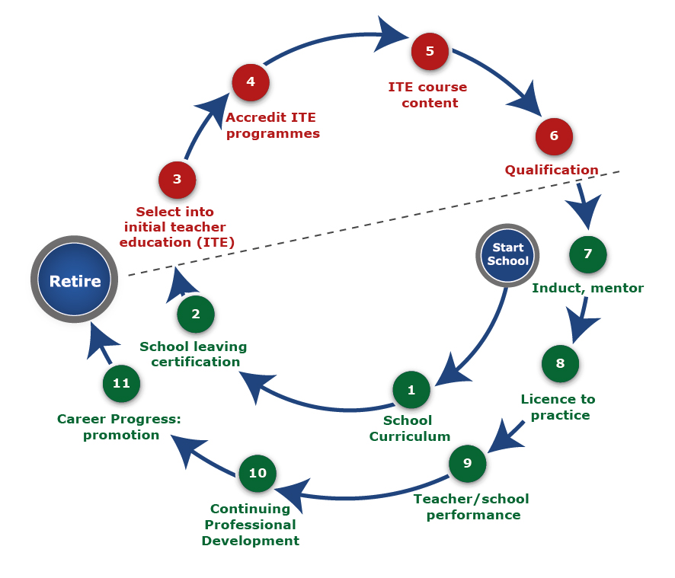
logic
Taylor 2017

Slide 5
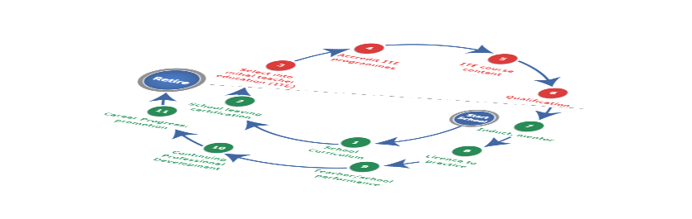
4
3
6
5
11
8
7
10
2
1
9
Highly detailed, often using the typical SAQA format
Some level of specificity
More generic, usually developed as a guiding framework
High level, “lighthouse” purpose

Slide 6
3
Advanced professional
5
2
COMPETENCE
Proficient
4
1
Basic competence
Initial
Mid-career
Highly experienced
Not yet achieving competence
EXPERIENCE
Adapted from Rusznyak, 2017

Slide 7



The heart of professionalism
the heart of
Professionalism and accountability improve teaching quality
Professionalism
Accountability
Professional Teaching Standards are an important tool through which values, professionalism and accountability can be defined and upheld
Values influence ‘powerful’ and professional accountability
Values are an essential component of a professional culture and commitment
professionalism
Values-based teaching and conduct
Hofmeyr 2017

Slide 8
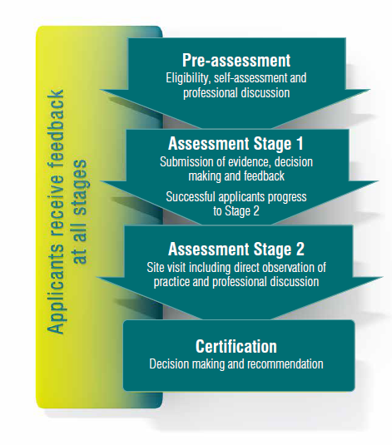

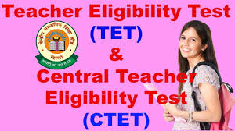


thinking about assessment
United States: very strong focus on electronic assessment system managed by an external and independent agency (Pearson/Stanford); types of assessments include: (1) subject content with PCK; (2) general; (3) professional standards
Australia: relies more on assessors combined with electronic portfolios which is a more labour-intensive option
India: The national teacher eligibility test (TET) provides a useful international benchmark with an electronic portal that is being developed
Scotland: well contained system that has rigorous system in place for many years
Reliable, valid, predictable, independent

Slide 9


Slide 10


Slide 11
some insights gained
Not all standards are equal
Technical and political processes are necessary
There is an interdependency between different standards in the cycle of schooling
There is an interrelationality between values, accountability and professionalism
We need to cater for a range of competencies and experience
Assessment is going to key
The process takes longer than planned
PrimTEd
4 May 2018

