Slide 1
Professional Development Framework for Digital Learning
Digital Learning Competencies
Joint Standards Working Group
https://goo.gl/tYebLz

Slide 2
Strategic Importance of Framework
White Paper on e-Education (2004)
Every teacher, manager…must have the knowledge, skills and support they need to integrate ICTs in teaching and learning.
Action Plan to 2019
improve the professionalism, teaching skills, subject knowledge and computer literacy of teachers throughout their careers.

Slide 3
Strategic Importance of Framework
ISPFTED 2011-2025
“specific teacher knowledge and practice standards”
“assessing teacher current competence and supporting them to develop”
Operation Phakisa
Supporting and clarifying teacher development recommendations

Slide 4
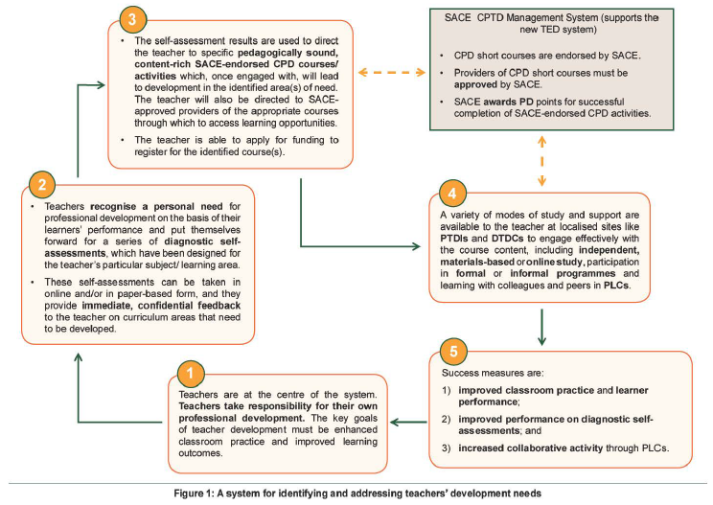

Slide 5
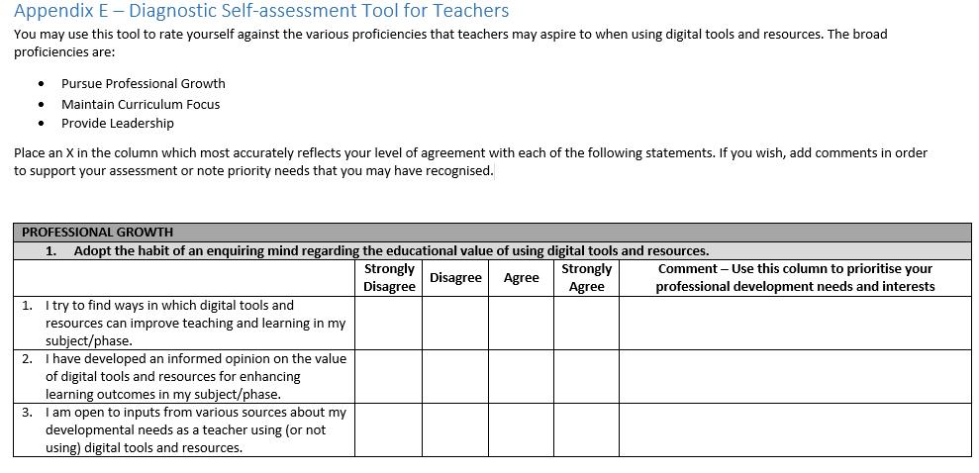

Slide 6
Lifelong professional learner
Wants to grow professionally
Identifies:
professional collaboration (Competency #4)
and learner collaboration (Competency #7)
A Professional Growth
4. Participate in local and global professional learning communities.
B Curriculum Focus
7. Develop learners’ global awareness and understanding through the use of digital communication and collaboration tools.
Notes:
Click on text to activate the two highlighted competencies
Click on image to activate the video - click play button once video placeholder image displays

Slide 7
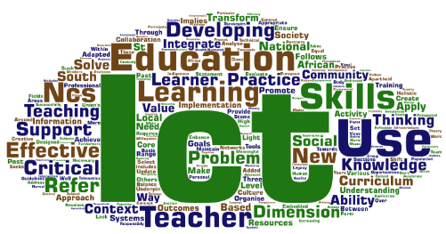
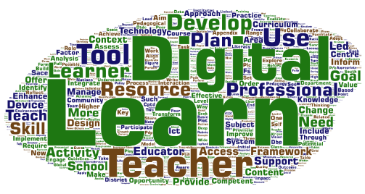
Guidelines (2007) -> Framework

Slide 8
Process
Draft
2016
Consult
DBE, DHET
Advocacy
Provincial roadshows
Expert reference group
PED
E-Learning
Curriculum
HEI
Providers of TPD
SMT
Teachers
SACE, Unions
Teachers
Key role players in provinces and districts
Competence and capacity
Implement
Approval
HEDCOM
CEM

Slide 9
Intended outcomes…
Education leaders with a plan for PD
Teachers prioritize PD needs
Learners achieve curriculum goals
Endorsed PD activities
New teachers as digital learners

Slide 10
Digital Literacy- Digital Learning
The Revised Policy on the Minimum Requirements for Teacher Education Qualifications, 2015 requires newly qualified teachers to have highly developed Information Technology (IT) skills.
The draft Professional Development Framework for Digital Learning (2017) views digital learning (encompassing e-learning and mobile learning) as a more modern expression of ICT integration, which is itself a broader concept than IT skills.
Notes:
The Revised Policy on the Minimum Requirements for Teacher Education Qualifications, 2015 requires newly qualified teachers to have highly developed literacy, numeracy and Information Technology (IT) skills. At face value this does not really require teacher training institutions to measure anything more than the students’ competence with computers/IT. However the Framework defines the contexts and scope of digital literacy (developing IT skills). We will address that later in this workshop.
The Framework has adopted the term “digital learning” to represent an integration of learning technologies as a resource during learning activities. This has significant pedagogical implications; in fact pedagogy is the determining factor that dictates how learning technologies are used. In some cases new technologies have made new learning experiences possible, which reinforce a range of learner-centred approaches and support the process of knowledge construction by learners. So, digital learning is really a more accurate description of ICT integration and definitely a more encompassing term than “computer literacy” and “IT skills”.

Slide 11
Context and Scope
DIGITAL LITERACY
DIGITAL LEARNING
Policy on Minimum Requirement for Teacher Education Qualifications
ISPFTED
“IT Skills” as basic competence of a teacher
Digital learning competencies
Defines scope of activity
Context: collective roles of teachers in a school

Slide 12
Digital Learning Competencies
“non-punitive system for assessing teacher current competence and supporting them to develop in areas of their individual need.”
Integrated Strategic Planning Framework for Teacher Education and Development, Output1, p4

Slide 13
Digital Learning Competencies
Professional Growth
Curriculum Focus
Leadership
the fundamental of professional learning
Curriculum learning objectives
vision and leadership for digital learning.
4IR learners – digital citizens
Notes:
The thirteen competencies are grouped into four groups as shown on this slide.
Proceed to apps demonstration.

Slide 14
Professional Growth
Adopt the habit of an enquiring mind regarding the educational value of using digital tools and resources.
Be reflective about challenging current digital learning and teaching practice.
Understand the roles of the teacher, learners and of digital learning resources when designing learning activities.
LIFELONG LEARNER
REFLECTION
TEACHER’S ROLE
Notes:
The thirteen competencies are grouped into four groups as shown on this slide.
Proceed to apps demonstration.

Slide 15
Professional Growth
Participate in local and global professional learning communities.
Select appropriate digital tools and resources when fulfilling the seven collectives roles of the educator.
PLC’s
DIGITAL LITERACY
Notes:
The thirteen competencies are grouped into four groups as shown on this slide.
Proceed to apps demonstration.

Slide 16
Curriculum Focus
Integrate digital tools and resources to enhance learning objectives in contrasting learning environments.
Develop learners’ global awareness and understanding through the use of digital communication and collaboration tools.
Transform learning through the innovative use of digital tools and resources.
INTEGRATION
ENGAGEMENT
INNOVATION
Notes:
The thirteen competencies are grouped into four groups as shown on this slide.
Proceed to apps demonstration.

Slide 17
Curriculum Focus
Enhance learning management, assessment and feedback through the use of digital tools and resources.
Integrate learner skill development in digital literacies with curriculum-based learning.
ASSESSMENT
LEARNER LITERACIES
Notes:
The thirteen competencies are grouped into four groups as shown on this slide.
Proceed to apps demonstration.

Slide 18
Leadership
Demonstrate commitment to the vision for digital learning in the province, district and school.
Participate in decision-making when planning and implementing digital learning in the school.
Initiate peer support and collaborative, work-place learning.
COMMITMENT
CHANGE LEADER
PEER COACHING
Notes:
The thirteen competencies are grouped into four groups as shown on this slide.
Proceed to apps demonstration.

Slide 19
Competencies App https://goo.gl/uFA6dQ

